Slide 1
Research Update 3

Slide 2
How to Determine # Dry Days in Excel
added new column is it zero
=IF([@[Daily Discharge (Mean)]]=0,1,0)
insert pivot table, year as row,
value as is it zero (dont need to count)
removed 1963 and 2020

Slide 3
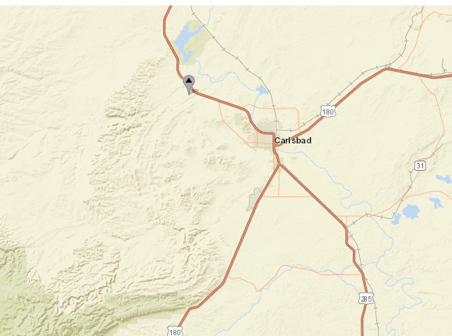
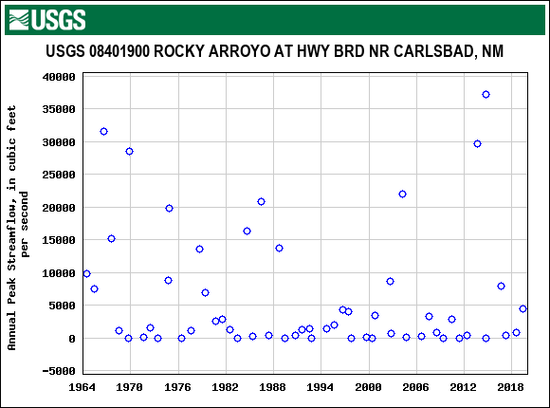
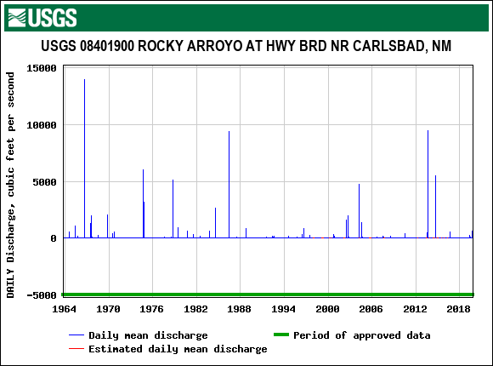
https://waterdata.usgs.gov/nwis/nwismap/?site_no=08401900&agency_cd=USGS https://snoflo.org/report/flow/new-mexico/rocky-arroyo-at-hwy-brd-nr-carlsbad/
Rocky Arroyo Gauging Station
-NW of Carlsbad,
-drainage Area: 285 sq. Mi
-not dammed

Slide 4
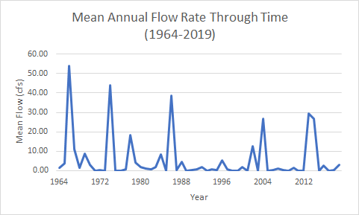
Rocky Arroyo Flow Regime
no flow days exploration
Turns out it only flows like 4 days a year…. So not much to explore in terms of dry days increasing
Better to explore days with flow over time
Flow is decreasing (both mean and # wet days)

Slide 5
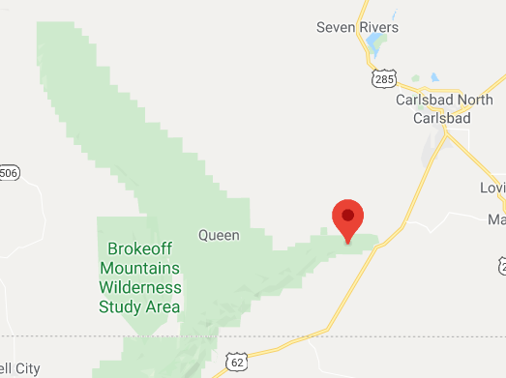
COOP Carlsbad Caverns Station 291480 https://wrcc.dri.edu/cgi-bin/cliMAIN.pl?nmccav
2/1/1930 – 7/17/2020
max/min/avg temp and precip at daily resolution
To access data: http://climate.ncsu.edu/cronos/?station=291480
DRI website doesn’t provide actual data, only gives climate normal based on data
Downloaded, title raw carslabd caverns stn climate data

Slide 6
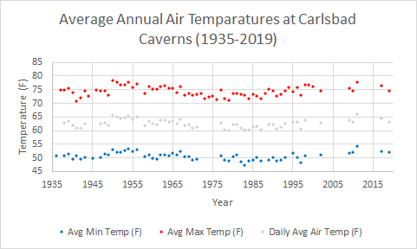
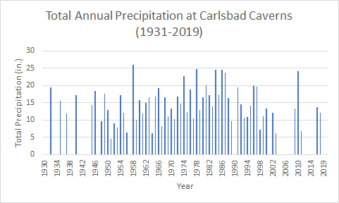
Carlsbad Caverns Station Results
removed years w/ <350 days of data
Can specifically look into years
normally wet or dry months missing?
Judge accordingly to include or not
Month | Percent Contribution
Sep | 20.0%
Aug | 15.6%
Jul | 14.6%
Jun | 10.3%
May | 9.7%
Oct | 9.1%
Apr | 4.2%
Dec | 3.6%
Nov | 3.6%
Mar | 3.1%
Feb | 3.1%
Jan | 2.9%

Slide 7
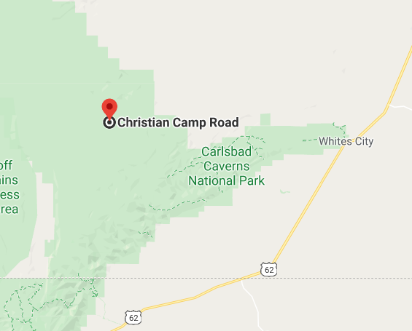
COOP Queen RANGER STATIOn 297176 https://wrcc.dri.edu/cgi-bin/cliMAIN.pl?nm7176
***wrcc.dri.edu… does not provide actual daily data, they only compute averages and 30-year climate summaries, hence why 1981-2010 tab is completely null, no data (same for other stations)
1/1/1963 – 3/31/1975 (contains 4044/4473 days)
daily precipitation (no temp)
To access daily data: http://climate.ncsu.edu/cronos/?station=297176
To access climate summaries: https://wrcc.dri.edu/cgi-bin/cliMAIN.pl?nm7176

Slide 8
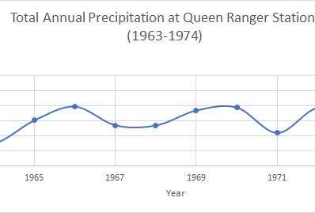
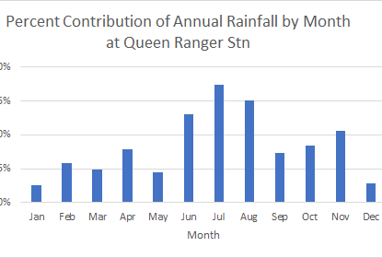
Queen Ranger Station Results
Year | Total Precip (in) | Count | Months Missing
1963 | 9.05 | 304 | Oct, Nov
1964 | 7.4 | 307 | Apr, Jun
1965 | 15.05 | 334 | Mar
1966 | 19.6 | 365
1967 | 13.43 | 304 | Nov, Dec
1968 | 13.36 | 242 | Jan, Apr, May, Aug
1969 | 18.33 | 364
1970 | 19.28 | 364
1971 | 10.91 | 361
1972 | 19.18 | 366
1973 | 14.63 | 242 | Jan, Apr, Aug, Oct
1974 | 26.8 | 360

Slide 9
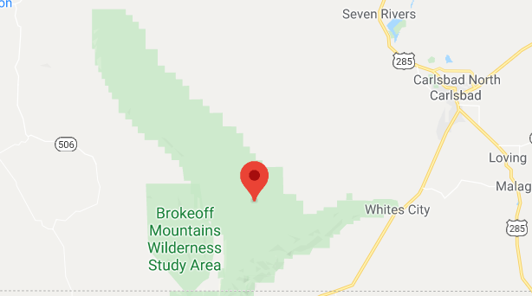
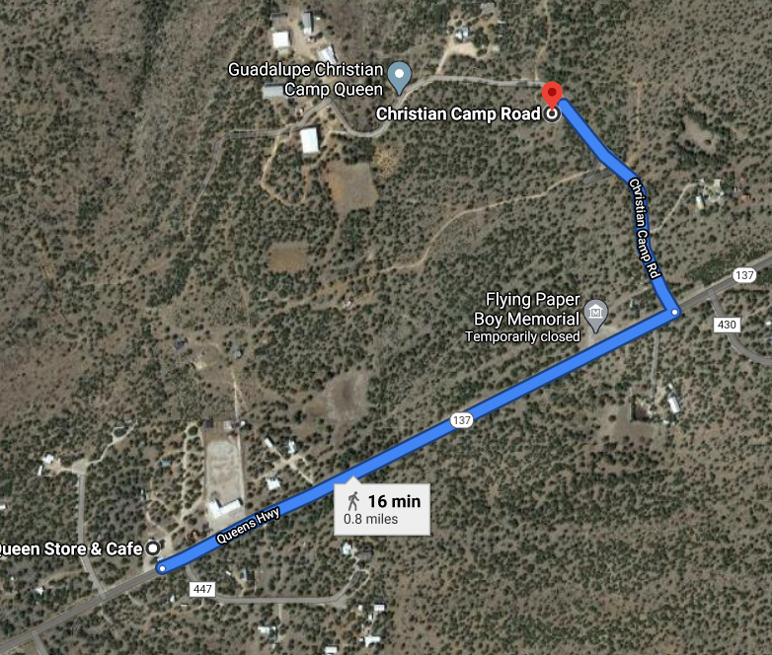
COOP Queen Station 297172 (no DRI climate summaries Exist For this station)
4/28/2000 – 3/7/2007
***2006 and 2007 are empty
Additional Queen station covering later period, .8 miles from Queen RS
max/min/avg temp and precip at daily resolution
Can download in standard or metric
To access data: http://climate.ncsu.edu/cronos/?station=297172
DRI website doesn’t provide actual data, only gives climate normal based on data
Downloaded, title raw carslabd caverns stn climate data

Slide 10
Queen Station Results not valid, insufficient data
Year | Total Precip (in) | Count | Months Missing
2000 | 16.83 | 221 | April, 1/2 may
2001 | 12.8 | 349 | couple days in sep
2002 | 11.56 | 330 | Sep
2003 | 7.69 | 354 | < half sep and nov
2004 | 34.02 | 329
2005 | 5.16 | 238 | july, aug, sep, oct

Slide 11
Southern options: make sure they arent at too high elevation or on top of peak
The bowl, carlsbad (city), carslbad cav, pine springs, pinery
Look into hourly to build individual storm hydrographs
Focus in on single storm events to see what they look like, doesn’t matter if whole dat set isnt complete just need enough for single storm events
Sam will look into better data for queen or carlsbad
Used this climate data to show that.....
Flash flooods do x
There are x dry days in the mountain range per year
Storms are getting flashier
Dry days increasing etc
Thinking about how that data can be manipulated to come up with a cnclusion \
\
How are they changing spatially or temporally
If not changing, what do they look like?
Build storm distribution for each of the stations,
Define importants storm characteristics
Ie amount, duration, etc
Do for hourly and daily stations , duration total water, max min etc
Send along to sam with raw data
Possibly do with thesis could get sams help
Goal:: have in the next month
Daily data: mean median max min, is there a temporal trend?
Stationarity paper from SWH!
SUM: ddata from carlsbad caverns, hourly from from texas stations, hourly from carlsbad
If data is unchanging, build a distribution
Min, mean max dfor daily etc
Duration, amount water, max amount, etc for hourly (more specific, singular storm events / characteristics to help rebuild storm in landlab)
-use daily station to justify wether water cycle is changing or unchanging in a certain area
-hourly data used to reconstruct storms (if determined it is unchanging)
Avg min max dev for average hillslopes in 5 channels

